Slide 1
Deep Neural Network for Image Classification
Layla Tame A01192934
Jorge Mendez A00816559
DEEP LEARNING

Slide 2
INTRODUCTION
Throughout the last years, artificial intelligence has grown exponentially and with it the branch involving machine and deep learning.
A big branch of what we know today as AI is deep learning, which uses neural networks.
Commonly used for classification algorithms.
Applied in all kind of industries: from music, medicine, all the way to manufacturing.
In this project: using a classification algorithm to determine whether an image is of a rose or another species.

Slide 3

DATA SET
1 file containing information on 209 images:
Each one with a size of 128x128 pixels.
Containing information on three different layers, one for each color (RGB).
10 different classification species found in the file.
80% used for training: 169 images
20% used for testing: 40 images

Slide 4

OBJECTIVE
Training a multi-layer neural network and using it to determine whether an input image corresponds to a rose or not.

Slide 5
METHODOLOGY
Initializing parameters.
Loop for n-iterations
Forward Propagation
Compute Cost Function
Backward Propagation
Update Parameters
Better the results of accuracy obtained in order to get a better classification algorithm using trial and error and by altering the hyper-parameters:
Learning rate
Number of iterations.
Number of layers
Number of neurons in each layer
Using a flattened array as an entry of 49152 neurons (128x128x3).

Slide 6
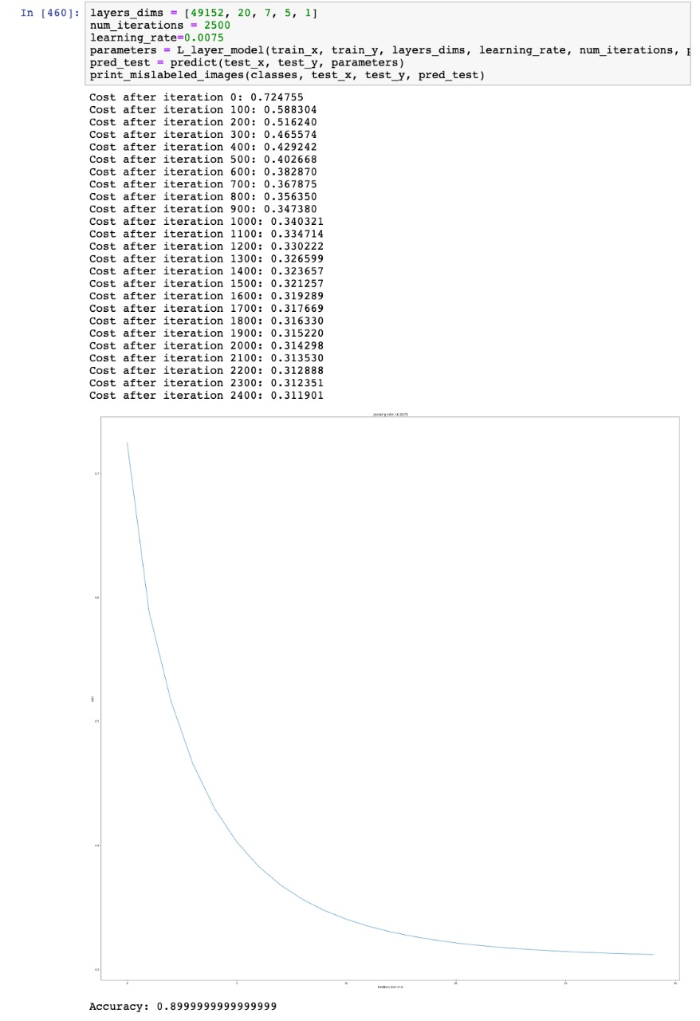
RESULTS
Running the algorithm with the initial parameters:
89.9% accuracy

Slide 7
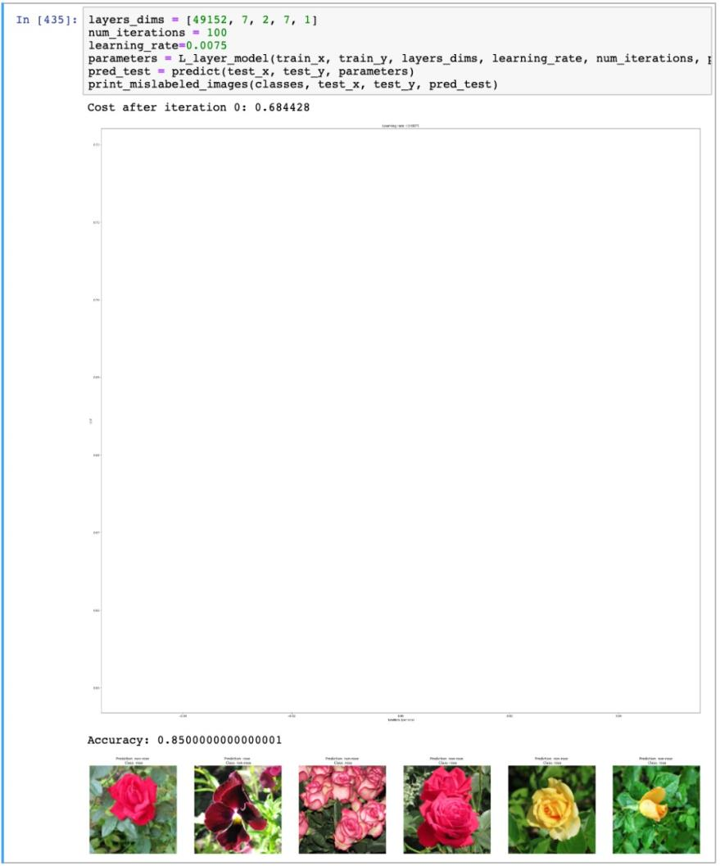
RESULTS
First experiment: reducing number of iterations
85% accuracy

Slide 8
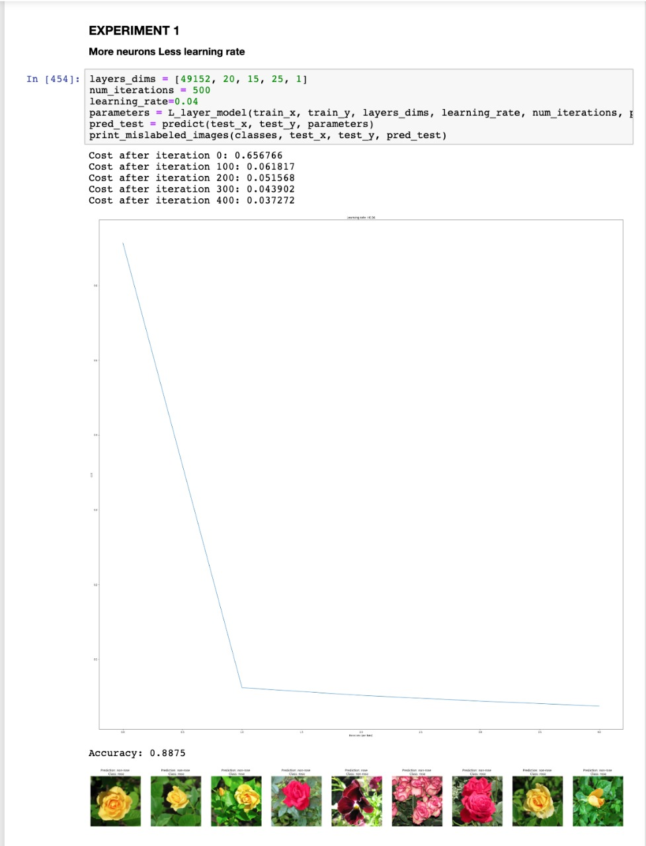
RESULTS
Second experiment: more neurons, less learning rate
88.75% accuracy

Slide 9
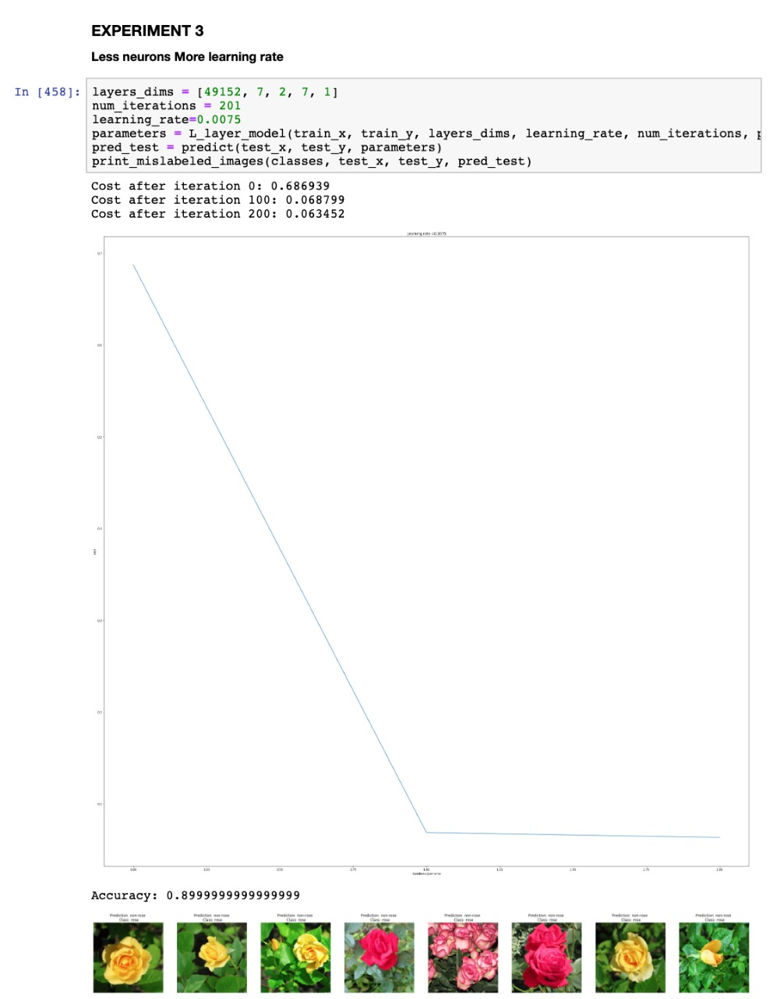
FINAL RESULTS
Best results obtained through: reducing neurons, increasing learning rate.
89.99% accuracy

Slide 10
CONCLUSIONS
It is very important to know the reason and logic behind every function being applied in order to optimize their use.
Knowing the functionality and purpose of every parameter can be a great tool towards knowing how to alter them in order to get better results.
It is important to look for an efficient algorithm, not just in terms of accuracy results but also overall performance, taking into account time taken to execute.
The best results were found by reducing the number of neurons and increasing the learning rate. Accuracy went up to 89.9%, meaning almost 9 out of every 10 images were correctly classified into the two existing categories.

